Slide 1
Ensuring Equity and Excellence Amid Funding Challenges
Dana DeVandry
EAD 510
Wednesday, July 24, 2024
LaRoyce Sublett
Notes:
Budget cuts are inevitable and it is important that an administrator knows how to maintain a strong learning community in the midst of this change.

Slide 2
How was our budget made?
Board members collaborate to form a budget that aligns with our mission and vision. This is evaluated and reviewed before district presents it to the directors.
The budget is maintained weekly by our administrators.
Notes:
The directors meet weekly to evaluate the needs from the wants, while making student learning and safety the highest priority.

Slide 3
Transportation
Salaries and Benefits
Instructional Materials
Professional Development
Health Aide
Facilities Maintenance
Extracurricular Activities
Administrative Costs
Notes:
These are all of the categories for the expenses listed in the annual budget.

Slide 4


Advocate for Kids
Does our budget support the needs of kids and keep up with emerging trends?
Aligning with our Continuous Learning Plan
Aligning with current trends in education
Notes:
Even in times of budget cuts, it is crucial to advocate for the needs of students. Sometimes we need to get creative and think out of the box. The decisions should align with our CIP, mission, and vision.

Slide 5
Digital Learning
Hybrid and Blended Learning
STEM
Social-Emotional Learning (SEL)
Project-Based Learning
Personalized Learning
Notes:
It is heavily talked about these days to help the child as a whole person, keeping in mind their SEL and mental health. (Vimeo, 2016).

Slide 6

Mental Health
Analyze the impact of cultural differences on students' mental health needs and support strategies.
Critique a current mental health policy in your school and suggest modifications based on emerging trends.
Design a new program that incorporates both mental health support and academic success strategies for at-risk students.
Notes:
Emotional Development: Good mental health helps children develop healthy emotional regulation, allowing them to understand and manage their emotions effectively.

Slide 7
Maintain meeting student needs even when budget cuts occur.
Tip:
Post Needs Online
Community Engagement
Utilize Volunteers
Our mission stands even after our budget has been adjusted.
Notes:
“...provide the best educational experience.” (ALA, 2024).

Slide 8

What to do when budget cuts occur. What’s the plan?
Follow these 6 steps.
Notes:
Budget cuts for schools are relatively common and can occur for a variety of reasons.

Slide 9

Be a good steward.
As a principal, it is crucial to maximize the use of our current resources, especially during periods of budget cuts. In addition to this, consider the following strategies.
Notes:
Being a good steward as a principal involves managing resources wisely, fostering a positive school culture, and ensuring that the needs of students, staff, and the community are met.

Slide 10

Technology
District purchases all technology needs. This is why this amount is not in our budget expenses.
Notes:
Since technology is heavily monitored by district, all requests for new technology go through them and are paid by this department.

Slide 11

Use the tools that we have in place.
Tip
We already have enough computer carts to be able to incorporate technology into the classroom daily. We can save funds towards repairs and replacements for the next year earned from our fundraisers.
Notes:
First, you need to know the tools that you have by keeping an accurate inventory.

Slide 12
2. Evaluate Staff Positions
Delay hiring new staff members or explore part-time employment options.
Part-Time or Minimize Positions:
Instead of getting rid of a position. Make the reading specialists part time or combine the two staff into one full time position.
Reduce a Paraprofessional Position: I would cut one position due to negative results observed on student progress.
Notes:
In light of the financial constraints facing our school, it is with great consideration and heavy hearts that we approach the difficult decision of staff reductions.

Slide 13
What are people saying?
Evaluate the data.
Reading Specialist Impact:
Data showing that students working with part-time reading specialists achieve similar progress compared to those with full-time support. This needs to be evaluated by observation.
Paraprofessional Impact:
Evidence that reducing one paraprofessional position does not negatively affect student progress, or highlighting negative outcomes that justify the reduction.
Reasons for a Staff Cut:
Ineffective teacher when they were helping in the classroom
No progress seen with this particular paraprofessional.
Notes:
This certain staff member sets off students, rather than helping them in a classroom environment. Changes need to occur in order to meet our student needs.

Slide 14

3. Do you really need to adopt a new curriculum to teach and for kids to learn?
Tip:
Many schools just need to learn how to use the current curriculum that they have. Another way to say this is, “Let the cake bake!”
Notes:
Our current curriculum has a lot to offer. Usually the problem is that we don’t know how to optimize its value. (Cavanagh, 2014).

Slide 15
4. Teamwork makes the dream work! Use your own staff to equip others.
(Many teachers are well equipped to make
our learning community stronger).
Tip
Minimize professional development activities to focus only on essential training.
This training can be led by fellow teachers who use our curriculum to its maximum potential.
Notes:
We want to build better schools. (TED, 2012).

Slide 16

"Alone we can do so little; together we can do so much."
— Helen Keller
Notes:
Collaboration is key. Collaboration in a school is essential for creating a cohesive and effective educational environment.

Slide 17
Examples
People need to hear the treasure of ideas brought forth from other staff.
Observations will be conducted based on a rubric after teacher collaboration in a professional development looking for…
Effective Teaching Practices
Were emphasized goals practiced immediately?
Student Engagement
Were practical ideas implemented to foster active participation?
Notes:
Regular Meetings: Hold regular meetings for teachers, staff, and administrators to discuss goals, progress, and challenges. Use these meetings to share information and brainstorm solutions.
Open Channels: Create open channels of communication through emails, newsletters, and online platforms where staff can share ideas and feedback.

Slide 18

5. Delay any NON-URGENT MAINTENENCE projects.
Tip
Postpone any maintenance projects that are not urgent
What are our current needs to ensure safety and learning?
Notes:
In light of our current budgetary constraints, we have made the difficult decision to delay certain non-urgent maintenance projects. Our primary focus remains on maintaining a safe and effective learning environment for our students and staff. By prioritizing our limited resources, we aim to ensure that essential services and critical maintenance needs are met without compromising the quality of education we provide.

Slide 19
What
What activities align with our mission?
Mission
“In support of the family, provide the best educational experience to as many students as possible in a moral and wholesome environment.” (American Leadership Academy, 2024).
6. Restrict Extracurricular Activities
Notes:
Our extracurricular activities need to be focused on our school’s mission and CIP (ALA, 2024).

Slide 20
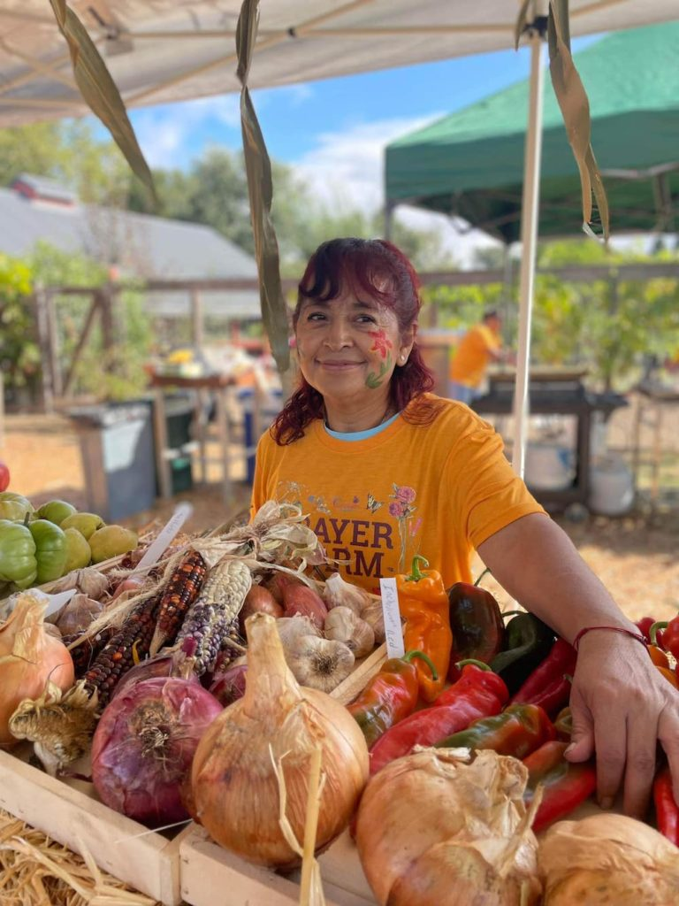
What strengthens our learning community?
Our school’s main event is the barn dance!
This is a fundraiser, but primarily a chance to feel a sense of community.
Notes:
Many times we already have a lot of the same resources to put on the same event annually.

Slide 21

Water Day supports our mission.
We want to show our appreciation of both the student’s hard work, along with the support that they’ve had at home.
A simple thank you goes a long way to build lasting relationships schoolwide, while keeping the price down.
Tip
Parents need to be able to celebrate their children’s accomplishments along with their teachers on this fun day!
Notes:
Showing appreciation to students and parents is key. There is always a way to collaborate to find a way to make this a frugal, yet fun day for everyone.

Slide 22
References
American Leadership Academy. (2024). Continuous Learning Plan. https://docs.google.com/presentation/d/1690FUQqtd4zFfZ4s2QltONf2_hPUULKiGpyXV2aDt6w/edit?usp=sharing
Dana DeVandry. (2024). Annual Budget. https://docs.google.com/spreadsheets/d/1CFi-OpxfUSEwcmLv9gKPhFgS-10_q1LrbVNVHLSafA0/edit?usp=sharing
American Leadership Academy. (2024). K-12 Student & Parent 2024-2025 Handbook. https://www.alaschools.org/az/parent-resources/handbooks/k-12

Slide 23
References
TED. (2012). Use Data to Build Better Schools. https://www.ted.com/talks/andreas_schleicher_use_data_to_build_better_schools?subtitle=en
Cavanagh. (2014). New Standards Sway Buying Plans. https://web-p-ebscohost-com.lopes.idm.oclc.org/ehost/detail/detail?vid=0&sid=a11c711d-a3b7-4d50-b85b-a6bb6a9cd332%40redis&bdata=JnNpdGU9ZWhvc3QtbGl2ZSZzY29wZT1zaXRl#AN=95759392&db=ehh
Vimeo. (2016). .A School that Builds with Community. https://vimeo.com/185783768

Slide 24
Remember 6 Steps:
Stewardship
Staff Changes
Current Curriculum
In House PD
Non-Urgent Maintenance
Restrict Extracurricular Activities

